Slide 1
Background
Uganda’s electricity sector faces high distribution losses.
Non-technical losses (theft/tampering) = 40–60% in urban areas.
UEDCL annual revenue loss: UGX 280B.
Manual detection <35% effective, delays of 3–6 months.

Slide 2
Problem Statement
Persistent theft threatens financial stability.
95% of meters lack real-time monitoring.
Losses projected to reach 25% by 2030.
Consumers pay 12–18% extra tariffs due to theft.
A Smart meter with AI capabilities represent a significant advancement in energy management, enabling real-time monitoring, predictive analytics, and automated responses to irregularities in power usage hence helping timely detection

Slide 3
Research Questions
How can an AI-Powered Smart Meter for Real-Time Anomaly Detection provide real-time monitoring in Uganda’s grid?
Which ML algorithms best detect theft patterns with accuracy and low false positives?
What technical, economic, and operational factors enable large-scale deployment?

Slide 4
Objectives
Main Objective:
To design, develop, and prototype an AI-based smart energy meter capable of accurate energy measurement and real-time power theft detection:
Specific objectives:
To integrate ESP32 microcontroller and PZEM004T.
To develop a robust IoT data pipeline for secure, real-time data transmission to a cloud platform
To train and deploy an ensemble ML model capable of distinguishing between legitimate load variations and theft patterns
To implement a user-friendly dashboard for utilities and consumers to monitor consumption and receive alerts

Slide 5
Significance of the Study
To UEDCL & Power Sector: Recover UGX 80–120B, reduce O&M costs by 25–35%.
To Consumers: Lower tariffs (8–12%), improved billing accuracy & trust.
To National Development: Supports NDP III, Vision 2040, SDGs 7 & 9.
To Academia: Provides empirical evidence on AI + IoT for African utilities.

Slide 6
Justification
Technical: IoT (ESP32 and PZEM004T) are affordable.
Economic: 30% theft reduction = UGX 84B recovery.
Operational: Aligns with UEDCL’s digitalization strategy.
Social: Fair billing, reduced corruption, community engagement.

Slide 7
Scope
Geographical: Kampala (Bwaise, Kisenyi, Katwe).
Technical: Three-phase 415V/50Hz, theft types (bypass, tampering, anomalies).
Temporal: 8 months (design → pilot → evaluation).
Content: Hardware, firmware, ML models, pilot deployment, analysis.

Slide 8
Literature Review
AMR Meters: Rule-based detection (e.g., shunt via current < 0.1 A) (Jones & Brown, 2021).
Limitations: Miss subtle tampering (e.g., partial diversion), delayed analysis, and no magnetic detection in budget models (Patel & Kumar, 2022; Kenya Power, 2023).
AI Solutions: Improve accuracy (>85%) but expensive, complex (Li et al., 2023).
Gap: No low-cost, real-time AI meters for East Africa’s unstable grid (190–250 V) (Mwangi & Ochieng, 2023).

Slide 9
Methodology
Hardware requirements:Microcontroller ESP32, PZEM-004T Module:
Software requirements:Arduino IDE,Jupyter Notebook,AI/ML frameworks(Tensor flow)lite,cloud platform-things speak

Slide 10
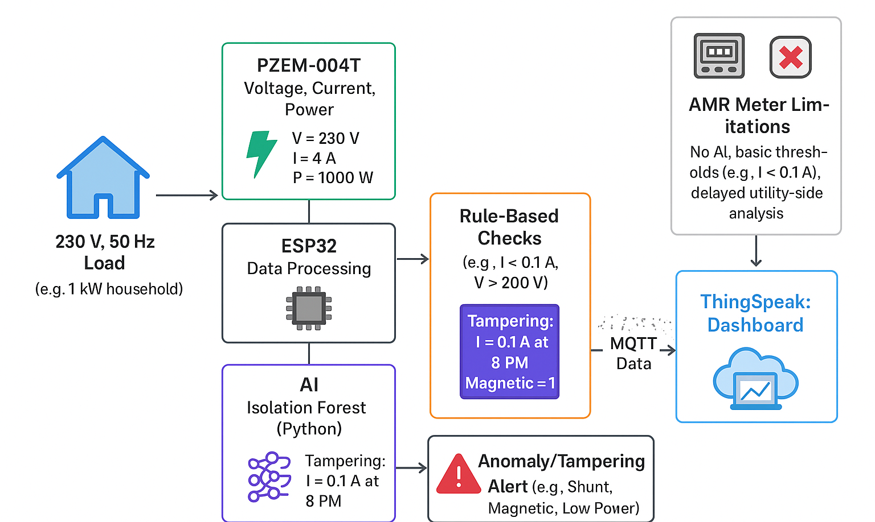
Data flows from load measurement to anomaly/tampering alert

